Slide 1


Slide 2


RSSI-Based Gradient Descent Approach for Collaborative Robot Localization and Navigation
First Year Project Synopsis
Submitted by
ROLL | NAME
2501940002 | Ram Kumar Singh
2501940014 | Shubham Goel
2501940019 | Jagdish Nayak
2501940055 | Tushar Singh
2501940065 | Vishakha Gaur
Faculty Mentor: Dr. Shweta Agarwal
Notes:
New Courses replaced with New Programmes

Slide 3

Project Overview
Collaborative robotic systems are increasingly used in environments where GPS and predefined maps are unavailable or unreliable. Traditional navigation approaches often depend on centralized control or external infrastructure, which limits scalability and adaptability. To overcome these challenges, this project proposes an RSSI-based gradient descent collaborative robot system that enables multiple robots to autonomously locate and coordinate with each other in unknown environments.
The system uses Received Signal Strength Indicator (RSSI) values obtained through wireless communication between robots as a measure of relative proximity. Each robot treats the RSSI value as an optimization objective and applies a gradient descent–based algorithm to determine the direction of movement that maximizes signal strength. By continuously adjusting movement based on RSSI variations, robots gradually move closer to one another and achieve coordinated behavior without GPS or centralized supervision.
The proposed approach follows a decentralized architecture, allowing each robot to make independent navigation decisions. This improves system robustness, scalability, and fault tolerance while minimizing hardware complexity. The intelligence of the system lies primarily in software-based optimization and decision-making. The effectiveness of the proposed method is demonstrated through simulation and/or minimal hardware implementation, making it suitable for applications such as indoor navigation, swarm robotics, warehouse automation, and search-and-rescue operations.
Notes:
New Courses replaced with New Programmes

Slide 4
Specific Objectives
To design and develop an RSSI-based collaborative robot system for autonomous navigation without GPS or predefined maps.
To utilize Received Signal Strength Indicator (RSSI) values as a feedback mechanism for estimating relative distance between robots.
To implement a gradient descent–based optimization algorithm for determining the optimal direction of robot movement.
To enable decentralized decision-making, allowing each robot to operate independently without a central controller.
To analyze the effect of RSSI variations on robot movement and convergence behavior.
To minimize hardware complexity by emphasizing software-driven intelligence and optimization techniques.
To validate the proposed approach through simulation and/or minimal hardware implementation.
To demonstrate the applicability of the system in real-world scenarios such as indoor navigation, swarm robotics, and search-and-rescue operations.
Notes:
New Courses replaced with New Programmes

Slide 5
Key Features
RSSI-Based Navigation:
Utilizes Received Signal Strength Indicator (RSSI) values from wireless communication to estimate relative proximity between robots without GPS.
Gradient Descent Optimization:
Applies a gradient descent–based algorithm to guide robot movement by continuously maximizing RSSI values.
Decentralized Control Architecture/Autonomous Operation:
Enables each robot to make independent navigation decisions without reliance on a central controller. The robot operates independently without human intervention, making real-time navigation decisions based solely on sensor feedback and RSSI measurements
Minimal Hardware Dependency:
Focuses on software-based intelligence, reducing the need for complex sensors or infrastructure.
Scalable Multi-Robot System:
Supports easy extension from two robots to multiple robots without major architectural changes.
Notes:
New Courses replaced with New Programmes

Slide 6
Project Usecases & Scope
Project Usecases:-
Search and Rescue Operations:
The robot can locate a wireless signal source (such as an access point or transmitter) using RSSI values, making it useful in signal tracking and source-finding applications. Useful in disaster-prone or hazardous environments where robots need to find and collaborate with each other without external infrastructure.
Indoor Robot Navigation:
Enables robots to navigate and coordinate in indoor environments such as offices, malls, and hospitals where GPS is unavailable.
Project Scope:-
The project focuses on the design and implementation of an ESP32-based autonomous mobile robot capable of navigating toward a wireless signal source using RSSI-based gradient descent techniques.
Enables robot collaboration in environments where GPS and predefined maps are unavailable.
Provides a software-driven solution for relative localization using minimal sensing infrastructure. Advanced sensor fusion and real-time obstacle avoidance.
The scope is limited to RSSI-based navigation and collaboration; precise absolute positioning and advanced sensor fusion are not addressed and are considered future improvements.
Notes:
New Courses replaced with New Programmes

Slide 7
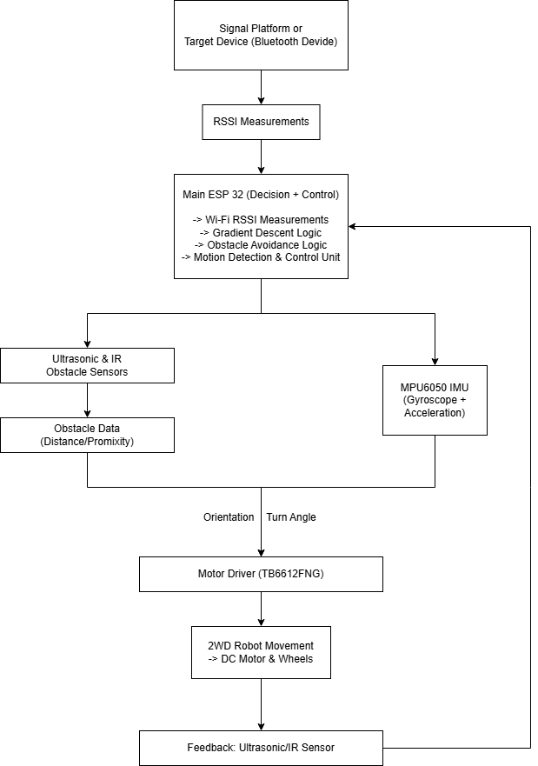
Prototype/Project Flow diagram/Architecture
Notes:
New Courses replaced with New Programmes

Slide 8
Data & Resources
Data Used
Wi-Fi RSSI Values:
Real-time Received Signal Strength Indicator (RSSI) values collected from a stationary Wi-Fi signal platform.
Sensor Data:
Distance and proximity data obtained from ultrasonic and IR sensors for obstacle detection.
IMU Data:
Orientation and angular velocity data from the MPU6050 for motion stability and turn accuracy.
System Logs:
Motor speed, direction, and navigation state data used for testing and optimization.
Resources Utilized
Hardware Resources:
ESP32 microcontroller, motor driver, DC motors, ultrasonic sensor, IR sensor, MPU6050 IMU, battery and power management components.
Software Resources:
Arduino IDE, ESP32 Wi-Fi libraries, embedded C/C++ environment.
Development Resources:
Serial monitor for debugging, datasheets and technical documentation.
Testing Environment:
Indoor lab/classroom environment with controlled obstacles and signal source placement.
Notes:
New Courses replaced with New Programmes

Slide 9
Methodology
The project uses an RSSI-based gradient descent approach for autonomous indoor navigation. The robot measures Wi-Fi RSSI from a stationary signal platform and iteratively moves in the direction of increasing signal strength to reach the target. Obstacle avoidance and motion stability are ensured using sensors.
Hardware
  ESP32 microcontroller
  TB6612FNG motor driver
  DC BO motors
  Ultrasonic & IR sensors
  MPU6050 IMU
  Li-ion battery with buck converter
Software
  Arduino IDE
  ESP32 Wi-Fi libraries
  Embedded C/C++
Flowchart Signal Platform → RSSI → ESP32 → Motor Driver → Motors Movements
↑
Ultrasonic / IR / IMU Sensors
Notes:
New Courses replaced with New Programmes

Slide 10
Expected Results & Impact
Expected Results
Successful autonomous navigation of the robot toward a wireless signal source using RSSI measurements.
Gradual and consistent increase in RSSI values as the robot approaches the target.
Stable movement and accurate turning with the help of IMU feedback.
Effective obstacle detection and avoidance using ultrasonic and IR sensors.
Reliable operation in indoor environments without GPS or vision systems.
Low power consumption and cost-effective system performance.
Impact of Project
Demonstrates a low-cost alternative to GPS and vision-based navigation systems.
Provides a practical implementation of optimization concepts (gradient descent) in robotics.
Enables easy scalability for multi-robot or swarm-based navigation systems.
Applicable to indoor navigation, research, and academic demonstrations.
Encourages development of resource-efficient and intelligent robotic systems.
Notes:
New Courses replaced with New Programmes

Slide 11
Project Timeline
Phase | Phase Name | Weeks | Key Activities
Phase 1 | Problem Definition & Planning | Week 1 | Problem understanding, literature review, finalizing objectives, scope, architecture design
Phase 2 | Hardware Selection & Procurement | Week 2 | Selection and purchase of ESP32, sensors, motors, power components
Phase 3 | Hardware Assembly & Wiring | Week 3 | Chassis assembly, wiring of ESP32, motor driver, sensors, and power unit
Phase 4 | Software Development | Weeks 4–5 | ESP32 programming, motor control, Wi-Fi RSSI measurement, navigation logic
Phase 5 | Sensor & IMU Integration | Week 6-8 | Ultrasonic, IR, and MPU6050 integration, obstacle avoidance implementation
Phase 6 | System Integration & Optimization | Week 9-10 | Integration of all modules, tuning RSSI thresholds, motion optimization
Phase 7 | Testing, Documentation & Presentation | Week 10-11 | Final testing, result validation, report writing, PPT and demo preparation
Notes:
New Courses replaced with New Programmes

Slide 12
THANK YOU

